Slide 1
Arduino and Photoresistors
Ryan Brock

Slide 2
About Me
Ryan Brock
Software Engineer – 14 Years
Purdue University – Computer Science
Motorola
Zebra Technologies

Slide 3
Contact
Twitter: @borq79
Email: borq79@gmail.com
Github Repo:
https://github.com/borq79/Cary-Area-Public-Library-Classes

Slide 4
Agenda
Review of some basics (15 mins)
Arduino
Breadboards
Resistors
LEDs
Introduction to Photoresistors (15 mins)
Voltage Division
Photoresistor Modules
Projects
Photoresistor determines LED brightness
Photoresistor LED Array
Light Trip sensor sends notifications to Twitter

Slide 5
Arduino Uno

Slide 6
Breadboard

Slide 7
Wiring up a Circuit

Slide 8
Resistors

Slide 9
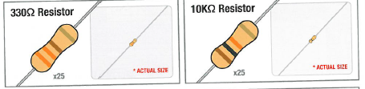
Vilros Kit Resistors
V = IR
I = V / R
I = 5V / 330 = 0.015A (15 mA)
I = 5V / 10,000 = 0.0005A (0.5 mA)

Slide 10
LEDs

Slide 11
Why is one lead longer?

Slide 12
Photoresistors

Slide 13
Photoresistor Simple Circuit

Slide 14
Voltage Division

Slide 15
Voltage Division
Assume
Vin = 5V
R1 = 100 Ohms
R2 Range is 0 to 100 Ohms

Slide 16
Photoresistor Module
A0 : Analog Output
GND : Ground
VCC : 5V Power
D0 : Digital Output (output is low when dark, high when bright)*
* The screw on the top allows you adjust the threshold for the digital output

Slide 17
Digital Write
The easiest of the two is using the built in function digitalWrite(). The digitalWrite() function takes in two values, the pin number and the value (HIGH or LOW). The digitalWrite() value is discrete and must be either HIGH (5V) or low (0V). This is useful if you simply wish to control if the LED is on or off (like in the blink example).

Slide 18
Analog Write
Turning the LED on and off is useful, however, if you wish to adjust the brightness of the LED you will need to use the analogWrite() function. The Arduino analogWrite() doesn't actually output an analog value but emulates an analog signal by configuring the pin as a PWM (Pulse Width Modulation). The analogWrite() function also takes two values, the pin number and the 'analog' value (0-255). 0 Means the pin will output a wave form with a 0% duty cycle (or basically 0V). As you increase the number towards 255 the duty cycle increases towards 100% (effectively 5V). The following diagram illustrates how the duty cycle of the output changes the wave form.

Slide 19
PWM

Slide 20
Project One Parts List
Arduino
Breadboard
USB Cable
1 LED
1 Photoresistor
1 330 Ohm resistor
1 10K Ohm resistor
5 Wires

Slide 21
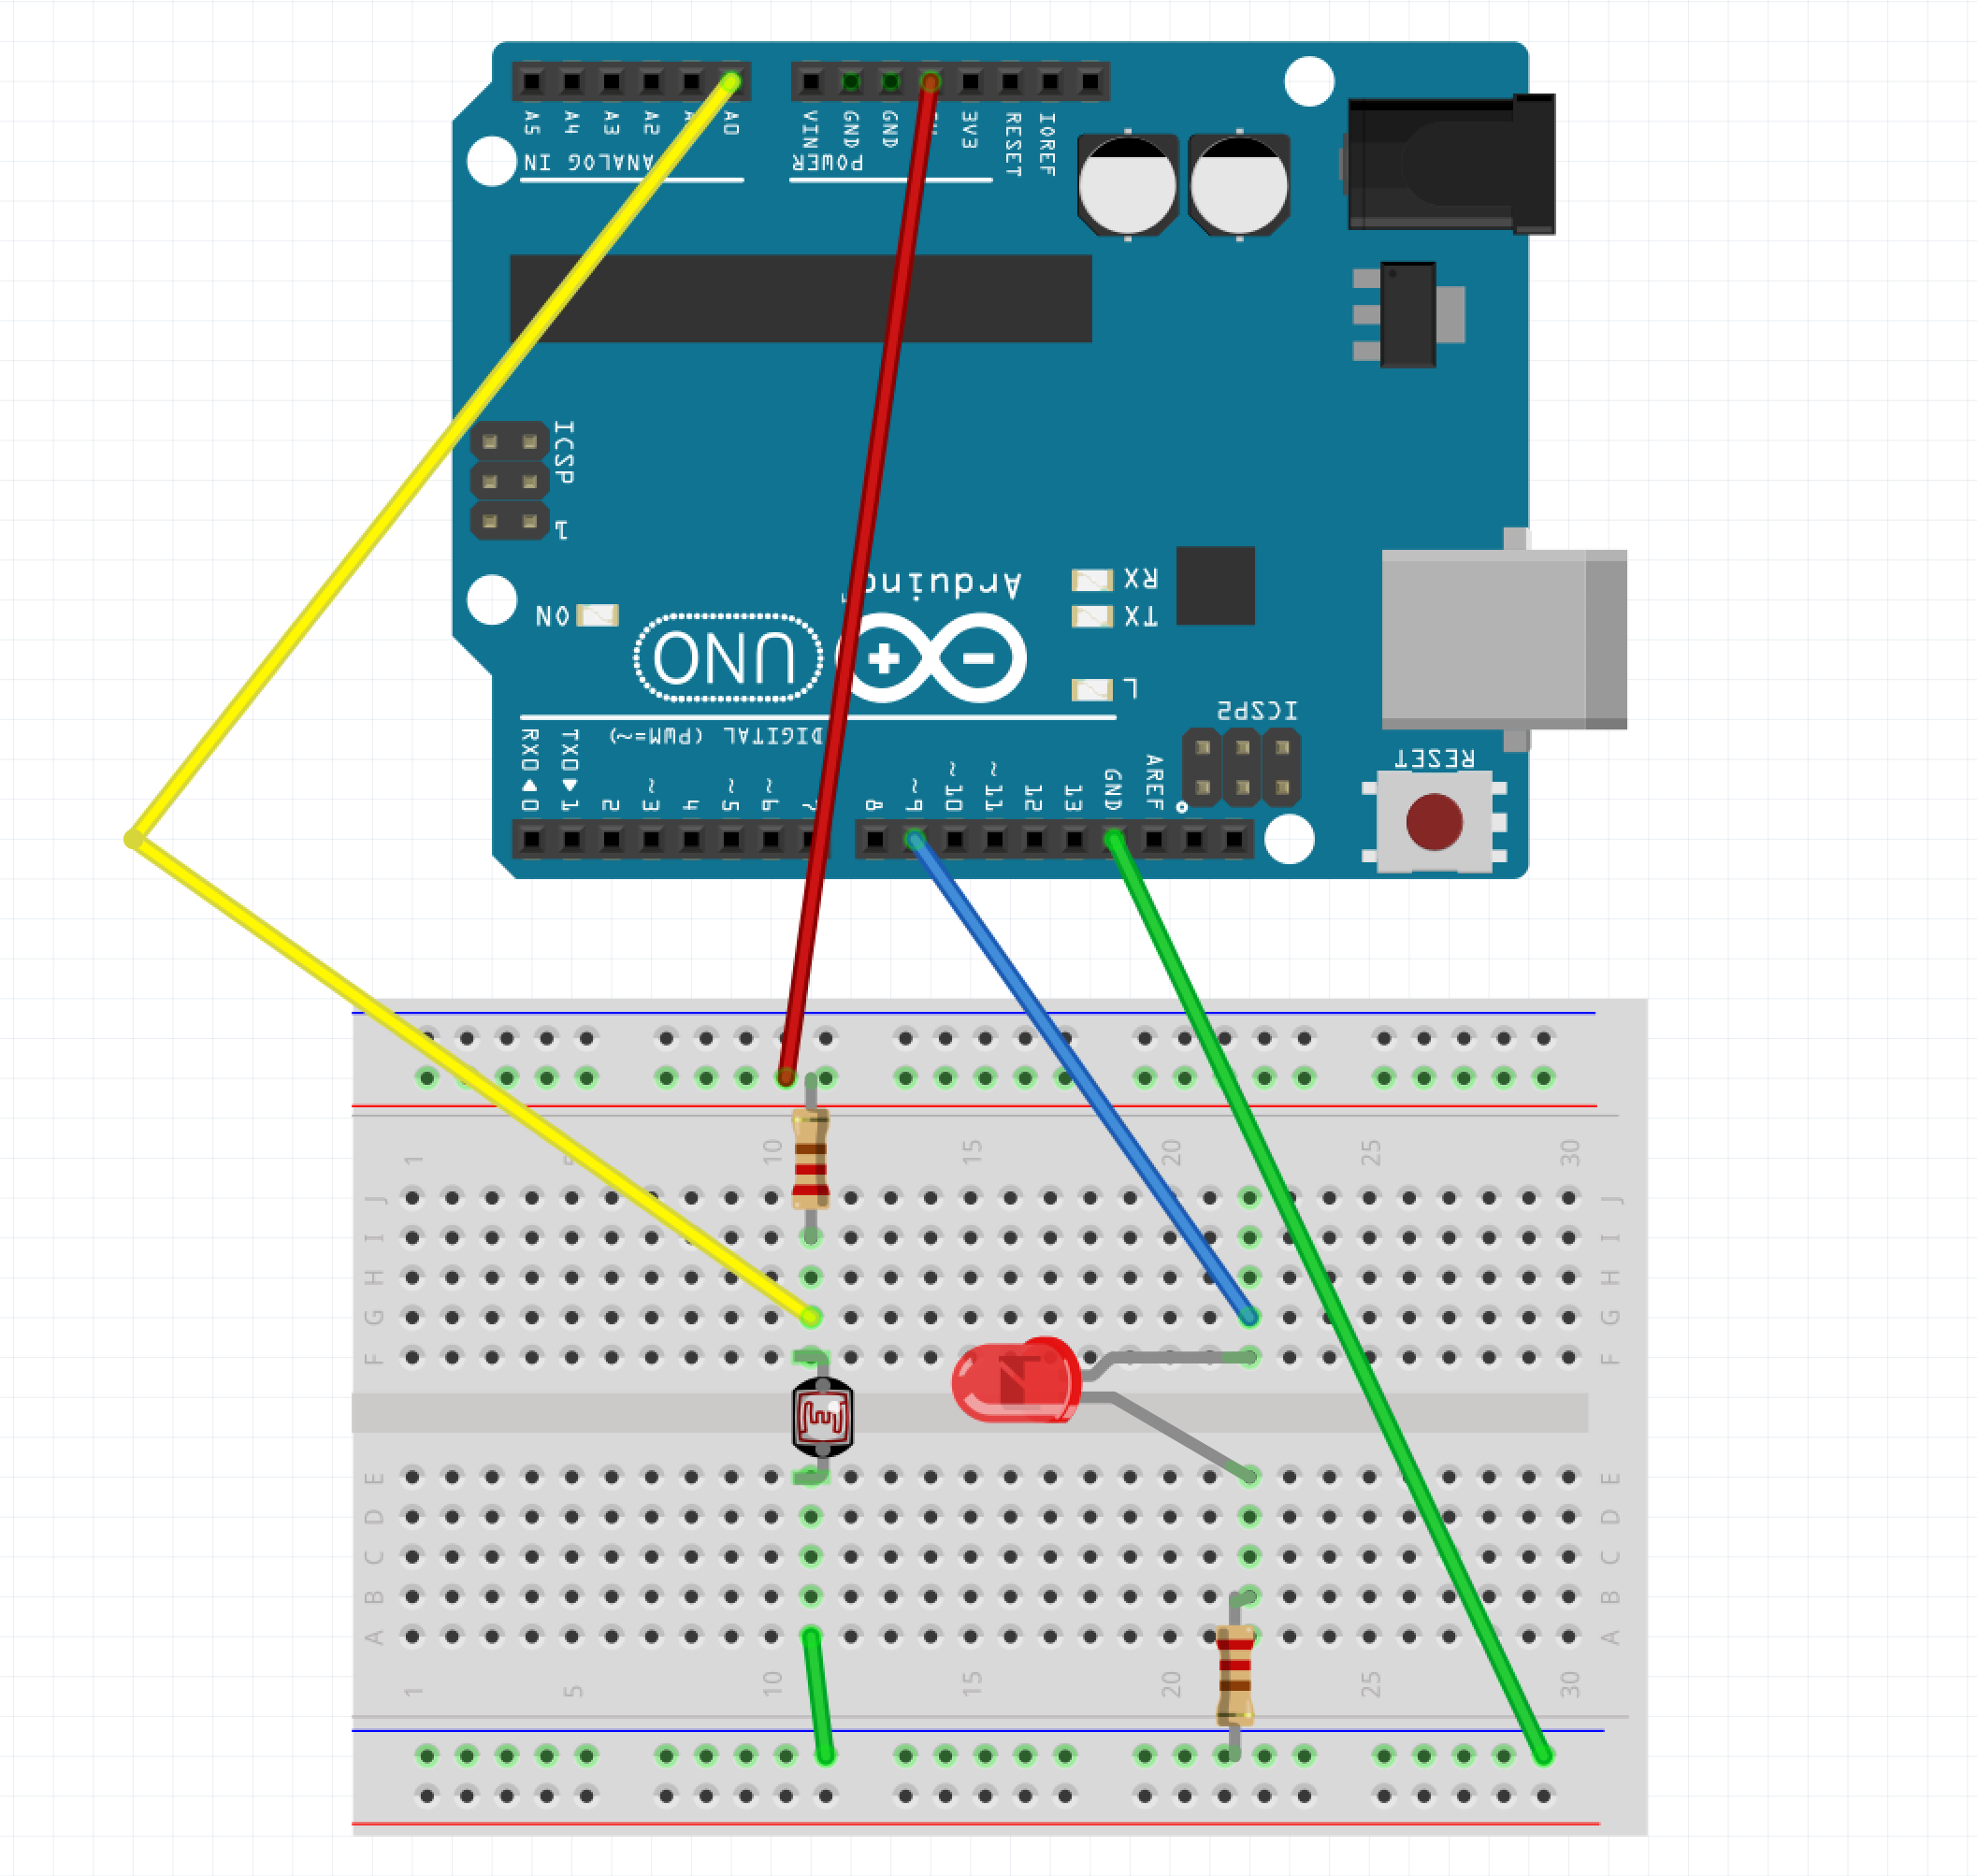
Project 1 Wiring Diagram

Slide 22
Project One Code
https://github.com/borq79/Cary-Area-Public-Library-Classes
Photoresistors
pcb_photoresistor_example
pcb_photoresistor_example.ino

Slide 23
Project One Parts List
Arduino
Breadboard
USB Cable
5 LEDs
1 Photoresistor
5 330 Ohm resistors
1 10K Ohm resistor
9 Wires

Slide 24
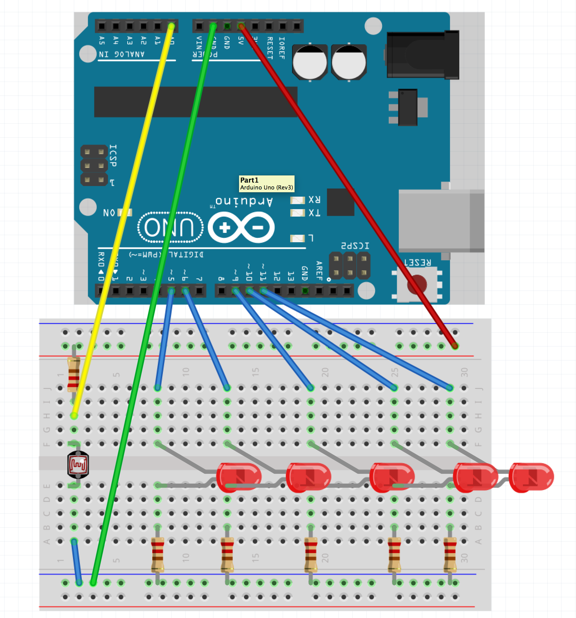
Project 2 Wiring Diagram

Slide 25
Project Two Code
https://github.com/borq79/Cary-Area-Public-Library-Classes
Photoresistors
pcb_photoresistor_led_array_example
pcb_photoresistor_led_array_example.ino

